Slide 1
Pyramid of Arclength Descriptor for Generating Collage of Shapes
Kin Chung Kwan^{1,2} Lok Tsun Sinn^{1,2} Chu Han^{1,2} Tien-Tsin Wong^{1,2} Chi-Wing Fu¹
¹The Chinese University of Hong Kong
²Shenzhen Research Institute, The Chinese University of Hong Kong
Notes:
Thank you for the introduction…

Slide 2


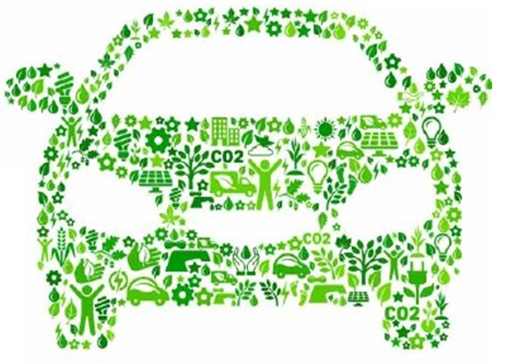
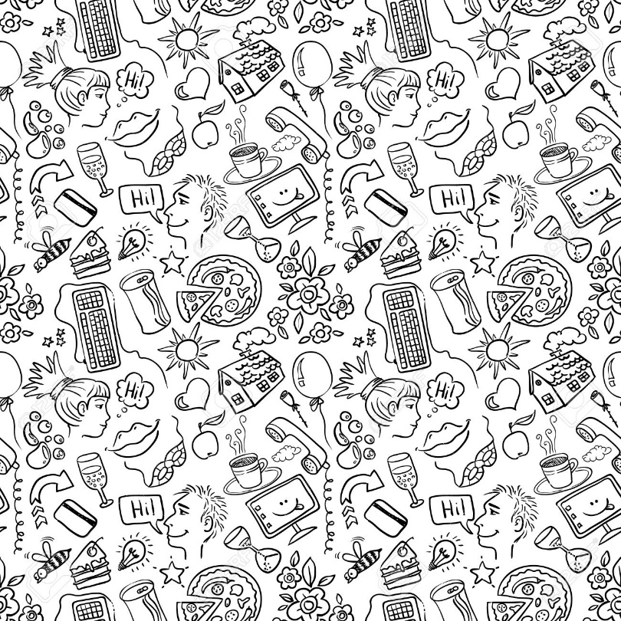

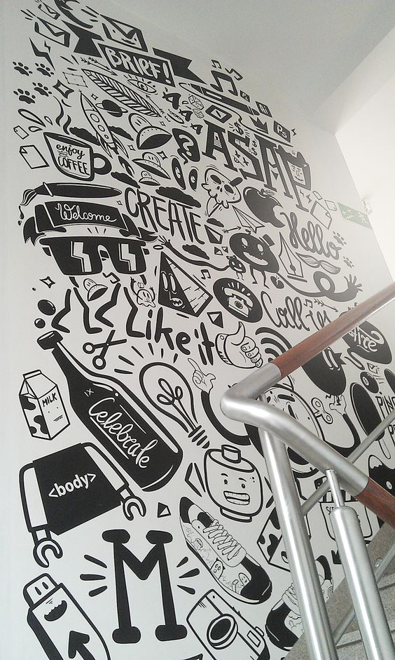


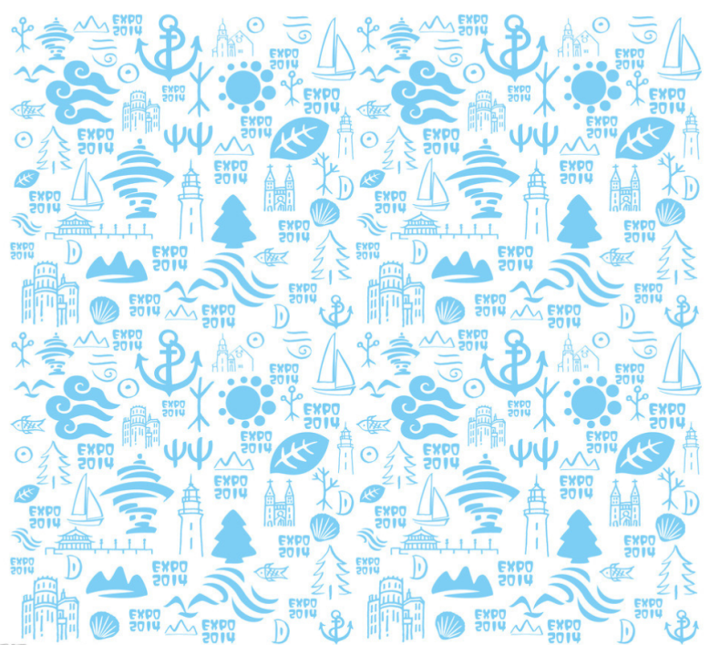
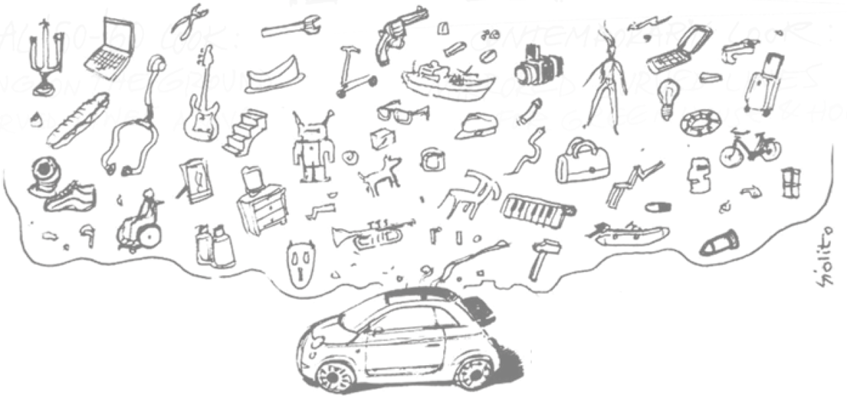
Collage of Shapes
Notes:
Collage of shapes <click> is a form of visual art created by putting shape elements such as clippings and icons together onto a 2D canvas. It has been extensively used in many areas such as commercial advertisement, 2D design, as well as in this siggraph poster.
To create this kind of collage<click>

Slide 3
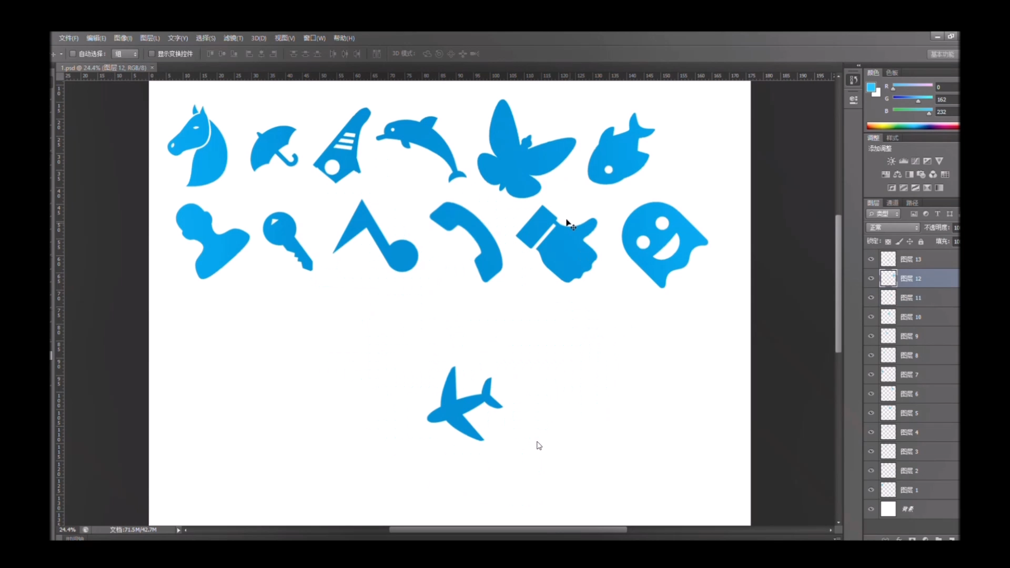
Manual Creation
Try all
Shape
Location
Orientation
Scale
Tedious and time consuming
Notes:
Artists need to pack the 2D shapes onto the canvas with different location, different orientation, and different scale.
They do it in a trial-and-error manner which is <click> very tedious and time consuming. <click>

Slide 4
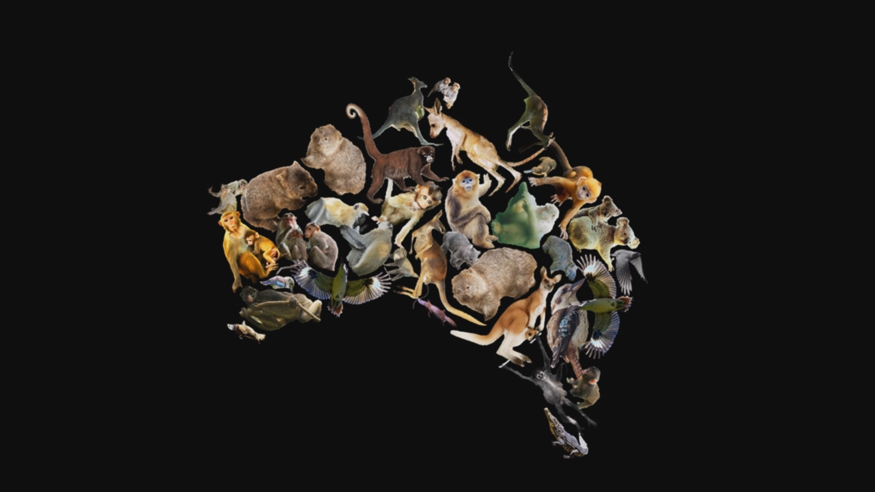
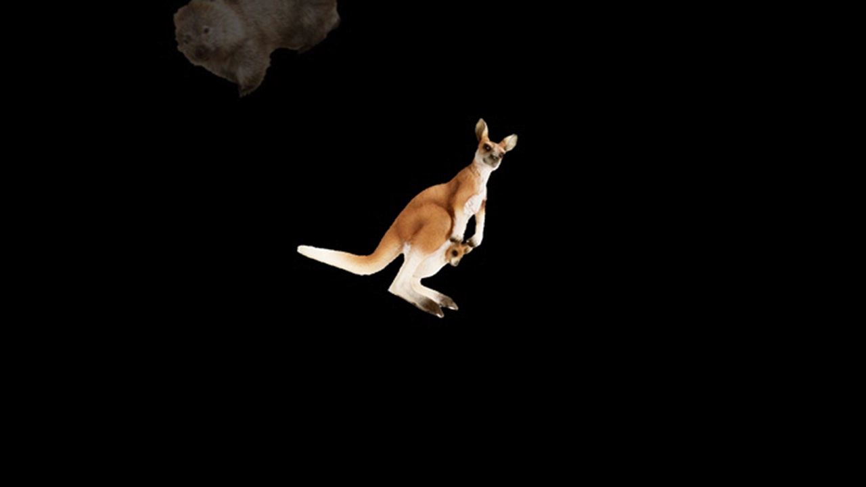
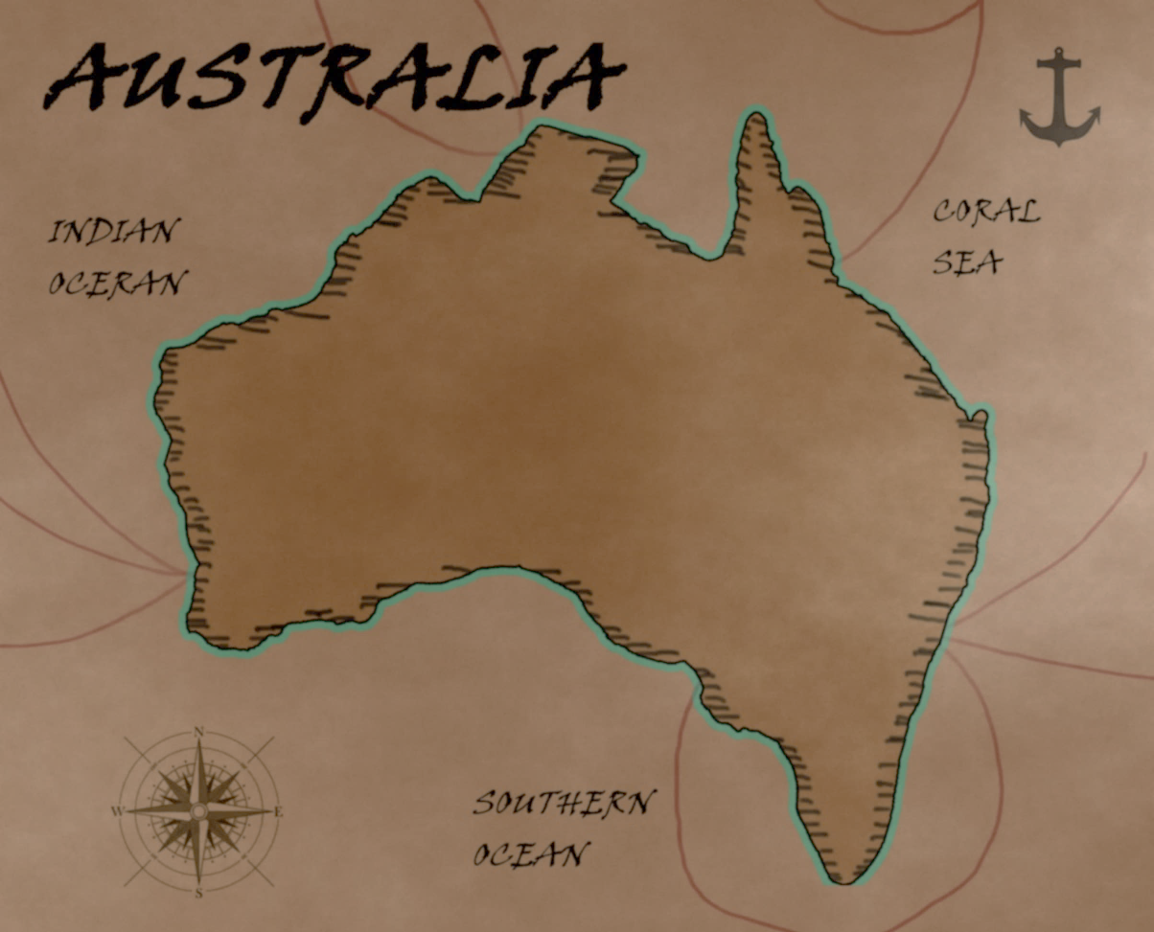






Our Goal
Automatically generating collage of shapes
High quality collage
Support arbitrary shape
Minimized gap and overlap
✗
✗
✓
Large gap
Large overlap
Good one
Notes:
In our work, our goal is to fully automatize this <click>generation process and generate collage of shapes efficiently. <wait animation-click>
To create high quality of collage, our method should support arbitrary shape and pack <click> them into the canvas with minimized gap <click> and minimized overlapping <click>.
To generate 2D collage automatically<click>

Slide 5

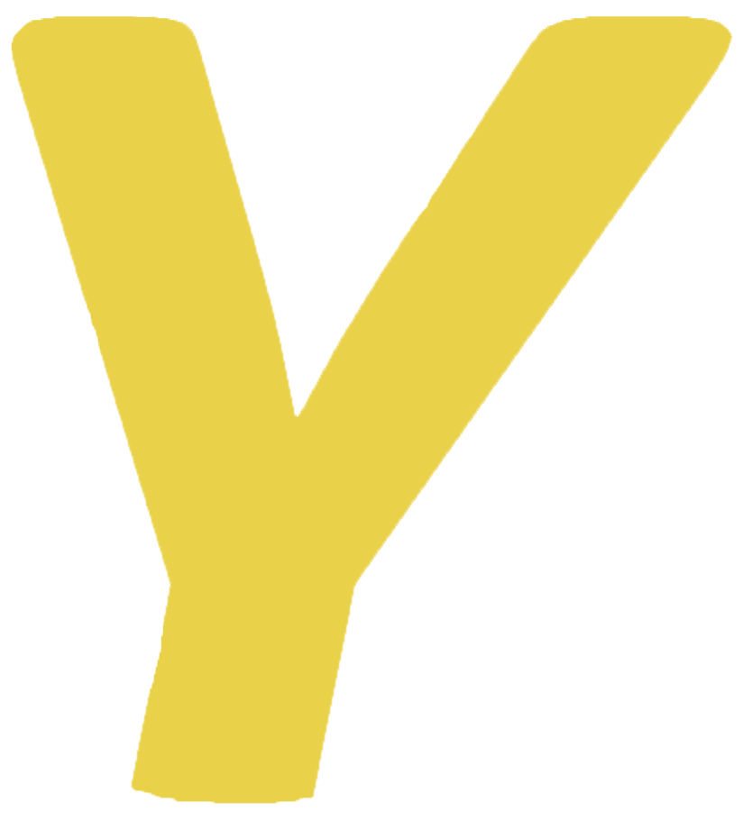


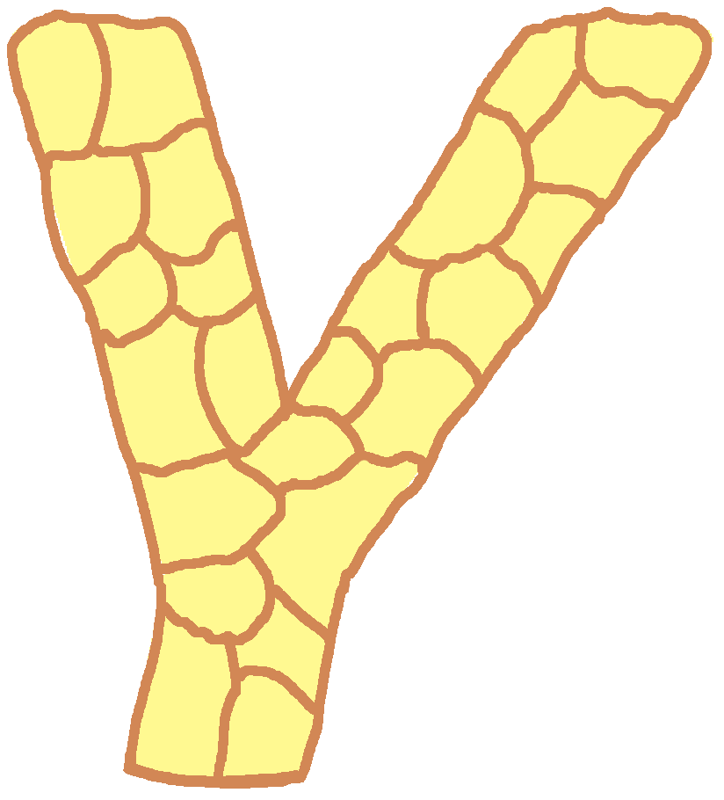
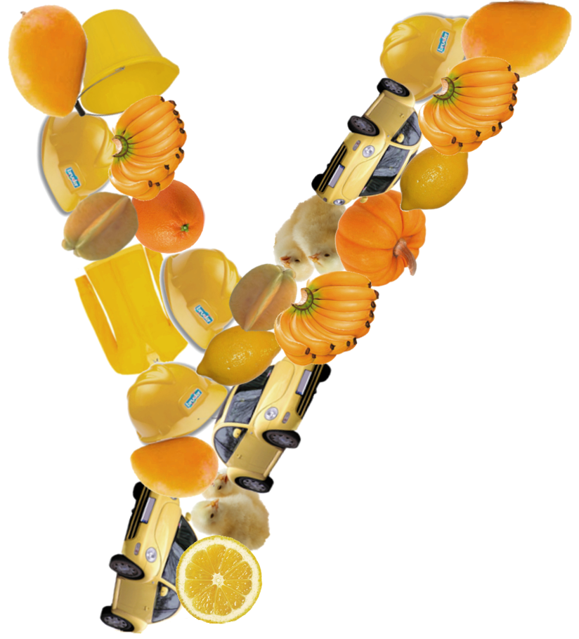













Collage Generation Methods
m
u
Top-down approach
[Kim and Pellacini 2002]
[Huang et al. 2011]
[Reinert et al. 2013]
Simple and fast
Convex shape
Bottom-up approach
Arbitrary shape
Strong shape coupling
Computationally expensive
Collage with
strong shape coupling
Notes:
There are two different type of approaches. The first one is <click>
top-down approaches. <click> Given a 2D canvas ,this approach subdivides <click>the canvas into multiple cells. Then<click> one shape is fitted into each cell to generate collage. <click> Most of the existing collage generation methods are using top-down approach as it is simple and fast. <click> However, the limitation of this approach is that it assumes the tiles must be more-or-less convex. Thus, they <click> cannot generate collage with strong shape coupling like this. To generate collage with strong shape coupling, we need to take another approach <click>, bottom-up approach. Given a shape on the canvas, we iteratively dock a new shape onto the boundary to generate collage. The advantage of this approach is that <click> it does not have any assumption on the shape of tiles. Such that it can support arbitrary shape and achieve strong shape coupling. But the major problem is that it is very computationally expensive, it is because… <click>
[Larger icon]

Slide 6
Bottom-Up Approach
Involves partial-shape matching
Find out similar boundary portion
Notes:
<click>The core of bottom-up approach is partial-shape matching. <click>
Given two shapes , we need to first find out their similar boundary portion in scale- and rotational-invariant manner.
Such that we can dock them together seamlessly by aligning their similar portion.
To perform shape matching, <click>

Slide 7
Partial-Shape Matching
Use existing shape descriptor
Extract many segments
Test all segments for matching
N x N x M x M comparisons
…
Similarity?
Huge search space
N sample points
N² segments
…
Starting point
Length
Starting point
Length
M sample points
M² segments
Notes:
We need to use shape descriptor.<click>
Existing shape descriptor can help us to measure the similarity of two shapes.
Thus, to apply it for partial-shape matching,
we need to extract many boundary segments with different starting points<click>, and different length<click>for comparison.
In order to find out the best matched portion, we need to compare<click> all possibilities of segments.
However, there are too many of them. <click>
Assume that there and N and M sample points on these two shape,
<N^2 segment and M^2 segment image>
There will be N^2 times M^2 comparison for testing all possibilities.
It involves huge search space and it is intractable. <click>
To make this problem trackable…<click>

Slide 8


Our Requirements
Point-based descriptor
Automatically define the local neighborhood
Scale-invariant
No need to test unlimited variance of segments
Reduce to N x M comparisons
More efficient
Notes:
Our idea is to have a <click>point-based shape descriptor that can describe the surrounding shape of a point. And this descriptor should<click> automatically define the local neighborhood when a point is interested. <click>
Most importantly, this <click>need be scale-invariant.
With this descriptor, we <click>do not need to test unlimited variance of segments at each point as it is automatically defined.
Thus, we only need to try all the point-pair on the boundary, which is <click>only N x M comparisons.
The search space is greatly reduced, <click> and it becomes more efficient.
To accomplish this…

Slide 9
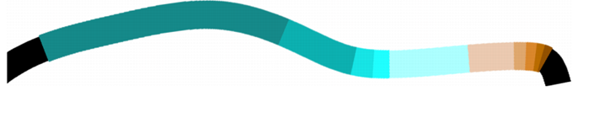
Pyramid of Arclength Descriptor (PAD)
Point-based shape descriptor
Describe surrounding shape in scale-invariant manner
Perform partial-shape matching efficiently
Simple and lightweight
P
Notes:
We present a brand new 2D shape descriptor, pyramid of arclength descriptor. In short, PAD. <click>.
PAD is a point-based descriptor, that <click>can describe the surrounding local shape of a point in scale-invariant manner.
<click>This pad can fulfill our requirements and perform partial-shape matching very efficiently.
<click>Moreover, it is very simple and light weight.
Now….. <click>

Slide 10
PAD Formulation
Notes:
I will introduce the formulation of our PAD.
To understand our PAD, we need to consider a basic case first <click>

Slide 11
Simple Case
Circles
Define the local neighborhood in scale-invariant manner
Notes:
circles <click>
Assume that now we are considering two points on two circles <click>
with different scale.
Our goal is to automatically define the neighborhood in scale-invariant manner.
To do so… <click>

Slide 12
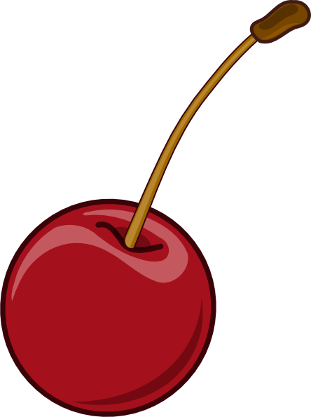
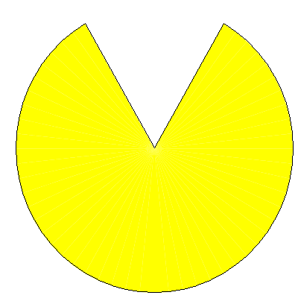
Scale-Invariant Quantity
A quantity that never changes in any scale
x
x
00
01
02
03
04
00
05
01
02
03
04
05
Equal quantity interval
Notes:
we need a scale-invariant quantity. <click> Imagine if we distribute cherry with equal interval of this quantity. To be scale-invariant, the number of cherry should never changes in any scale <click>. Such that having same amount of these quantity, we can have the same shape in any scale. <click>

Slide 13
Integral of Absolute Curvature (IAC)
Curvature changes inversely with arclength during scaling
X =
Curvature
Arclength
Product
(IAC)
Notes:
There exists a quantity that can fulfill this requirement, <click>
which is the integral of absolute curvature, IAC. <click>
It is because curvature changes inversely with arclength during scaling. <click>
Thus, when the shape is scaled, their product remains constant. <click>

Slide 14
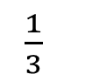
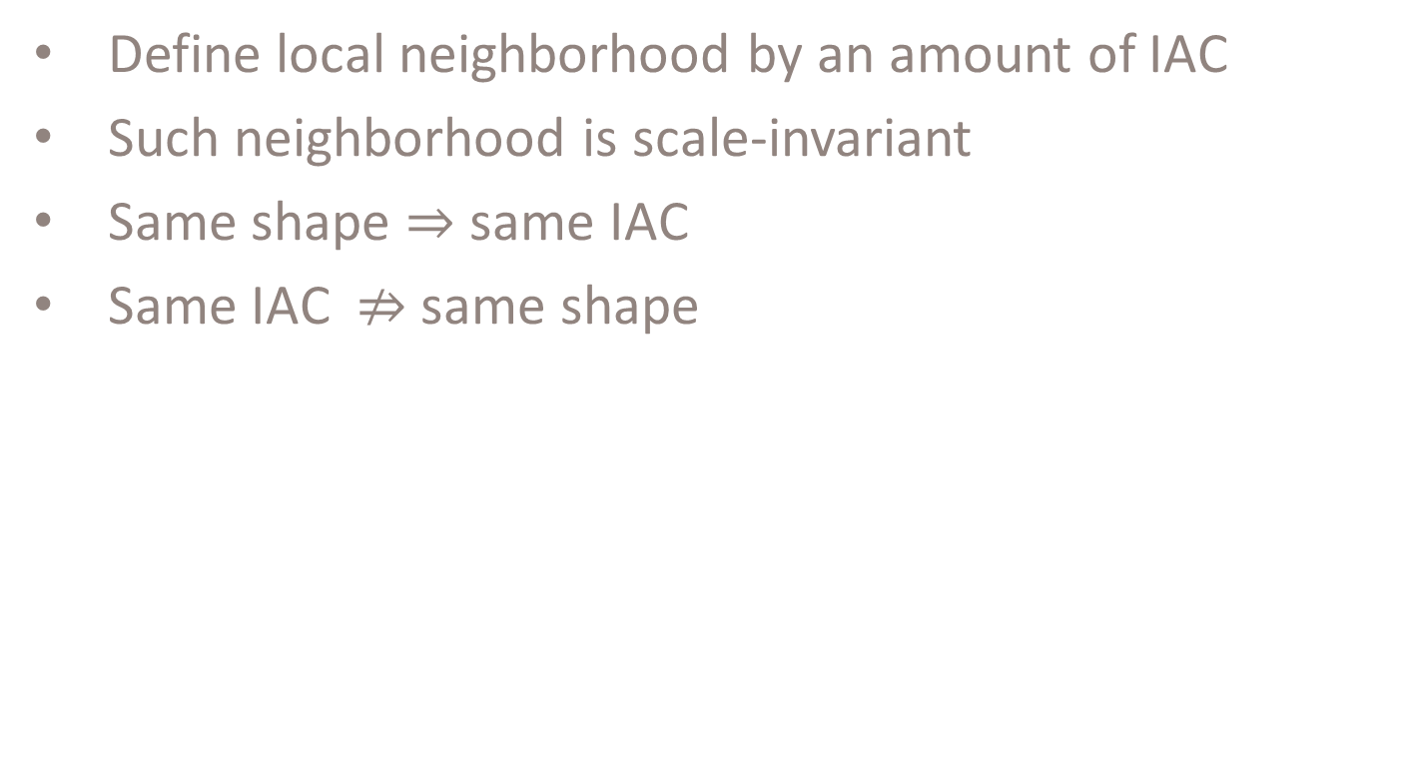
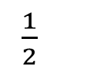
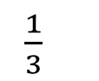
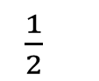
Using IAC
Define local neighborhood by an amount of IAC
Such neighborhood is scale-invariant
Same shape $⇒$ same IAC
Same IAC $⇏$same shape
Unit IAC interval
$\frac{1}{2}$
$\frac{1}{3}$
$\frac{1}{2}$
$\frac{1}{3}$
P
P
Multi-level design
P
Notes:
With this IAC, now we can define the local neighborhood by specifying an amount of IAC, instead of explicitly specifying the segment endpoints or arclength.
And such neighborhood is obviously scale-invariant.
<click> Since same shape must has the same IAC in any scale. <click> If two shape is identical, we can obtain same shape for the neighborhood <click>
However, same IAC does not imply that they must have the same shape.
There can be false positive cases. <click>
We found that if we subdivide it and use multiple levels with less IAC, we can reduce the false positive chance. <click>
This leads to a multi-level design for our PAD. <click>

Slide 15
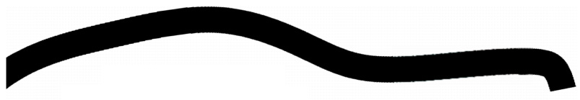
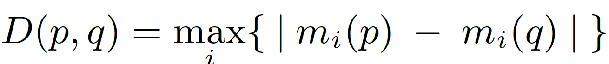
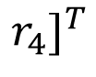
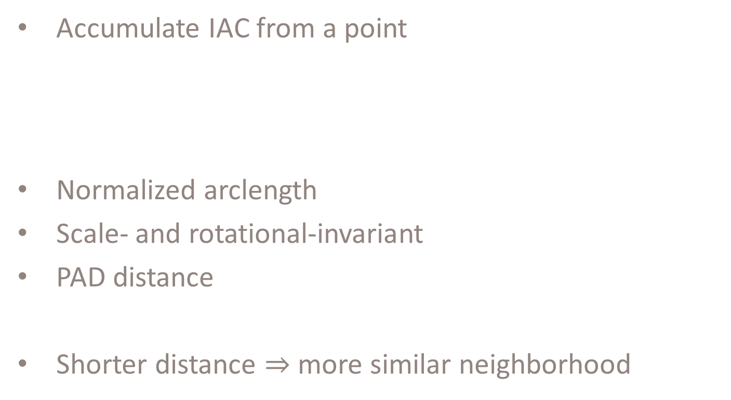
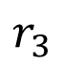
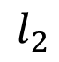
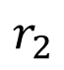
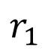
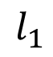
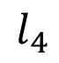
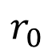
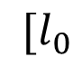
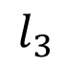
PAD Vector
Accumulate IAC from a point
Normalized arclength
Scale- and rotational-invariant
PAD distance
Shorter distance $⇒$ more similar neighborhood
P
$${[l}_{0}$$
$$l_{1}$$
$$l_{2}$$
$$l_{3}$$
$$l_{4}$$
$$r_{0}$$
$$r_{1}$$
$$r_{2}$$
$$r_{3}$$
$$r_{4}]^{T}$$
Notes:
By using this idea, we can extract our PAD from a point by accumulating IAC to one direction.
To increase the describing power of PAD, we also accumulate IAC to other direction.
The normalized arclengths of these interval form our PAD vector.
Obviously, our PAD is scale and rotational-invariant.
To compare the similarity of two PADs, we defined the PAD distance as their infinity norm distance.
As a shape descriptor, PAD has one interesting property that, if the pad distance of two points is shorter, the neighborhood of these two points are more similar.
Thus, we can apply it to our partial-shape matching problem.

Slide 16
Partial-Shape Matching with PAD
With PAD
N x M comparisons
Without PAD
N x M x #O x #S comparisons
Notes:
Given two shape, if we want to find out their similar portion using PAD.
We first need to extract PADs along the boundary.
Then we search for PAD pairs that have low PAD distance.
We search all the points along the boundary.
Obviously ,It requires ONLY N x M comparisons.
On the other hand,
With a naive point-based approach without PAD, we need to test different orientations and scales.
After we move to next points, we need to test it again.
It requires N x M x number of orientations x number of scale comparisons.
Obviously, our pad is more efficient.
And this efficiency is the key for our collage generation.

Slide 17
Collage Generation
Notes:
Now, we can apply our partial-shape matching to our collage generation problem.
Our bottom-up framework is simple.

Slide 18
Our Bottom-Up Framework
Seed shape
Partial-shape matching
Notes:
Given a library of shape, we manually select one shape as the seed shape.
Then we perform partial-shape matching to all the candidates in the library.
This allow us to find out similar boundary and dock them together.
To dock two shape together…

Slide 19
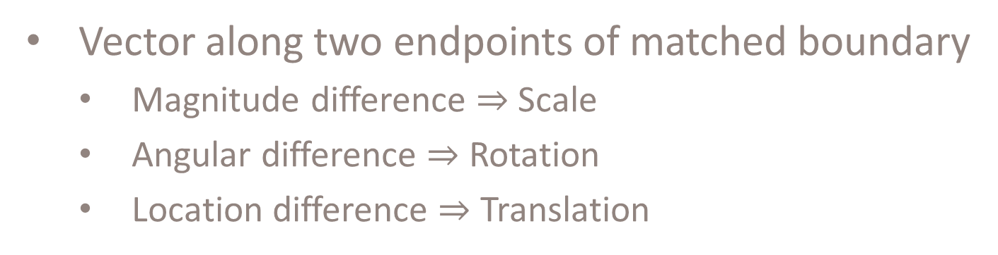
Docking of Two Shapes
Vector along two endpoints of matched boundary
Magnitude difference $⇒$ Scale
Angular difference $⇒$ Rotation
Location difference $⇒$ Translation
Notes:
we can use the matched boundary found by our partial-shape matching.
Assume that the orange line is their similar portion.
<click> We first form a vector from the two endpoints of the similar portion.
<click> The magnitude difference becomes the scale of the docking
<click> and the angular difference become the rotation.
<click> The location difference is the translation of docking.
By using this transformation…… <click>

Slide 20
Our Bottom-Up Framework
Objective function
Seed shape
Partial-shape matching
Area of gap
Area of overlap
Highest Score
Notes:
we can find out the dockings results among all the candidates in library.
Among them, we need to select the best one for our collage.
We do this with a simple objective function.
<click> Instead of only considering the matching length, we may also consider the area of gap and area of overlap in the ultimate objective function.
By using this objective function, we can select the best one with highest score and use it as a new seed shape.
Then we start our next iteration and perform shape matching again to generate collage.
By using this bottom-up framework, we can generate many interesting…

Slide 21
Results
Notes:
Collage result.
Here, we will show some of them.

Slide 22
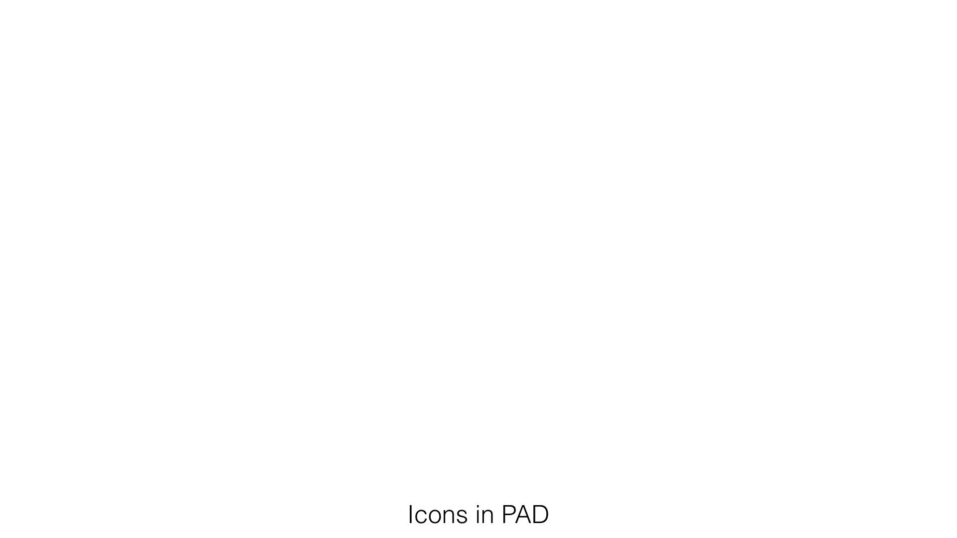
Result
Icons in PAD
Notes:
Here is a result using icons.
The tiling sequence is the actual docking sequence during generation.

Slide 23

Result
Australia animal
Notes:
Here is another results using animal to fillin Australia.

Slide 24
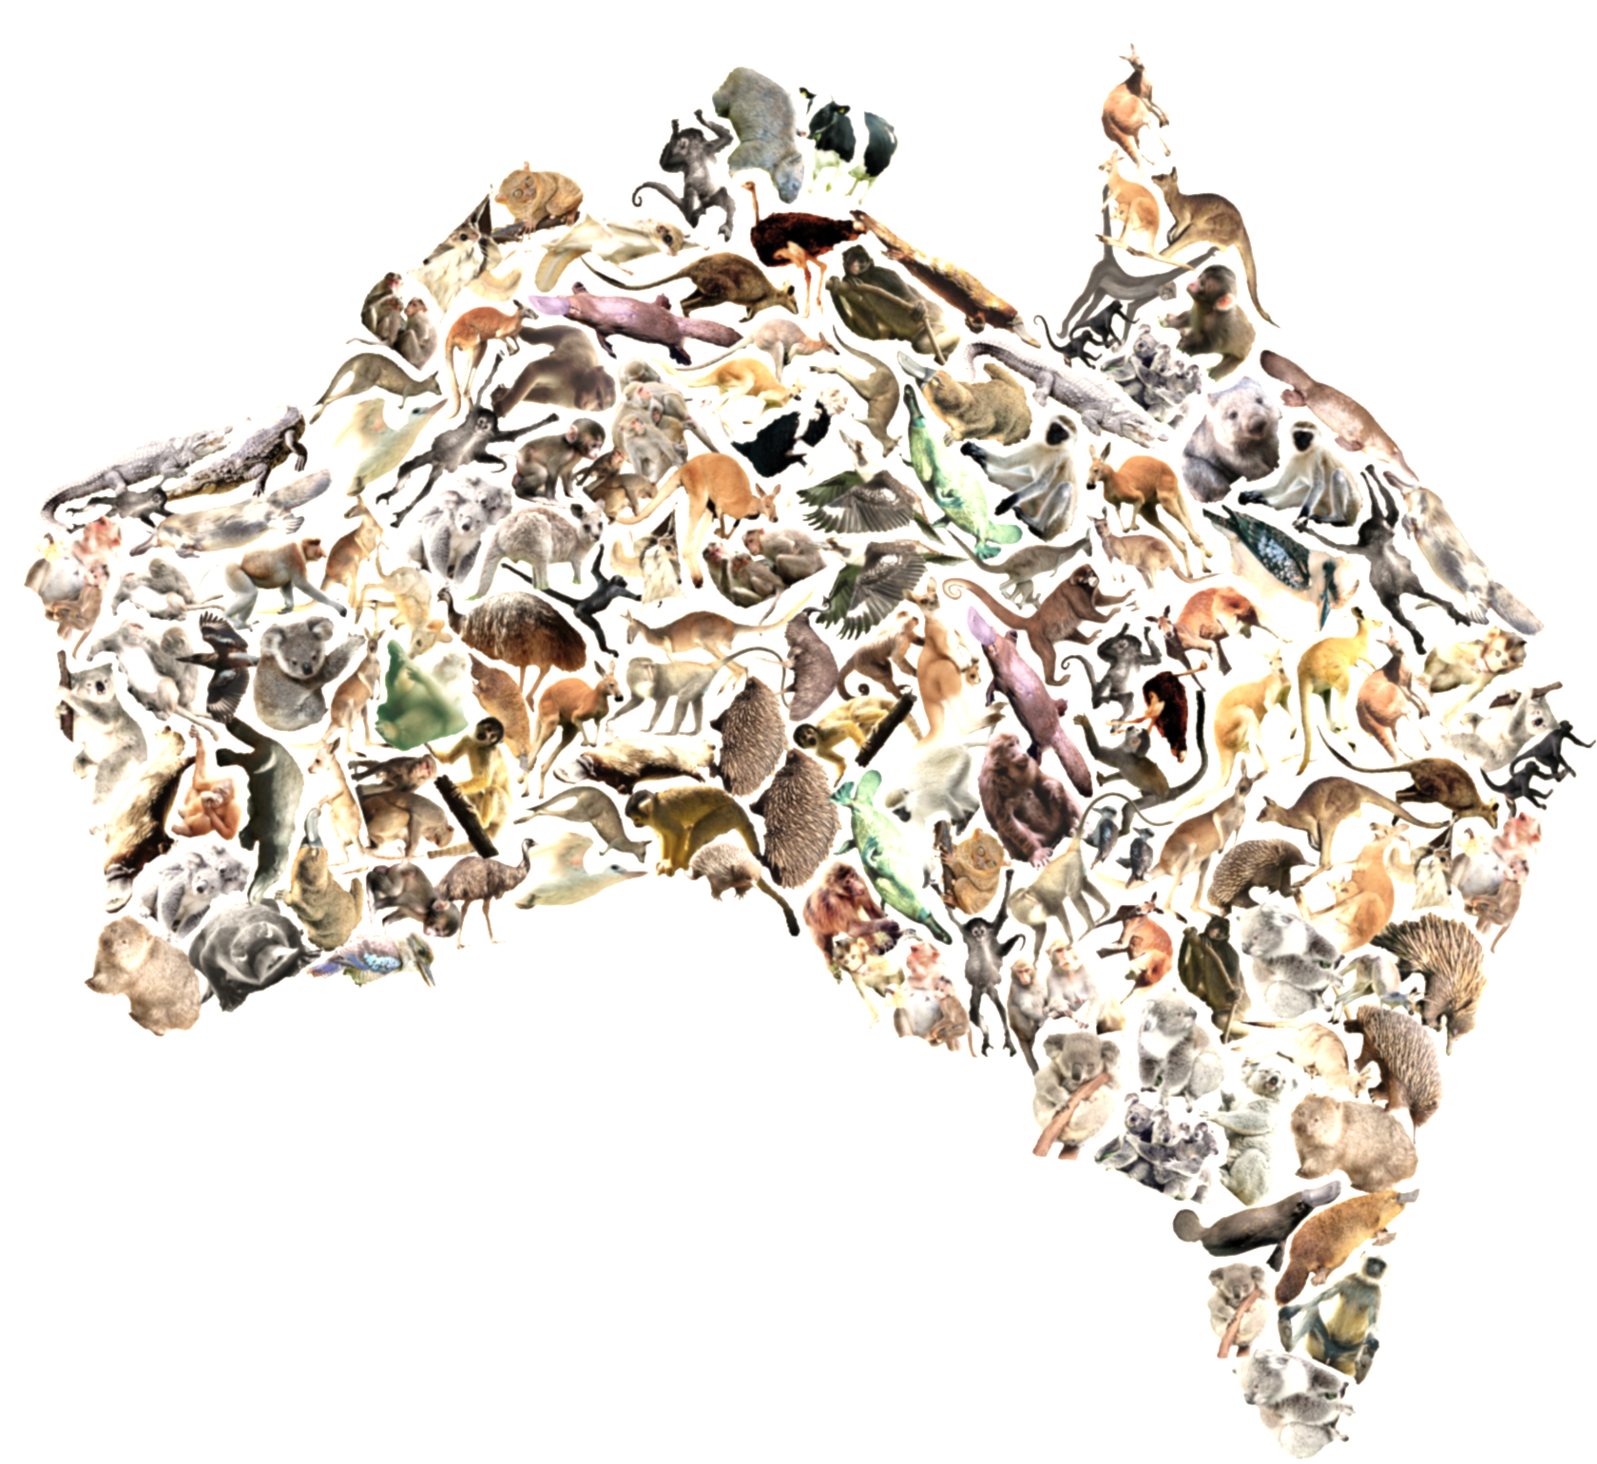
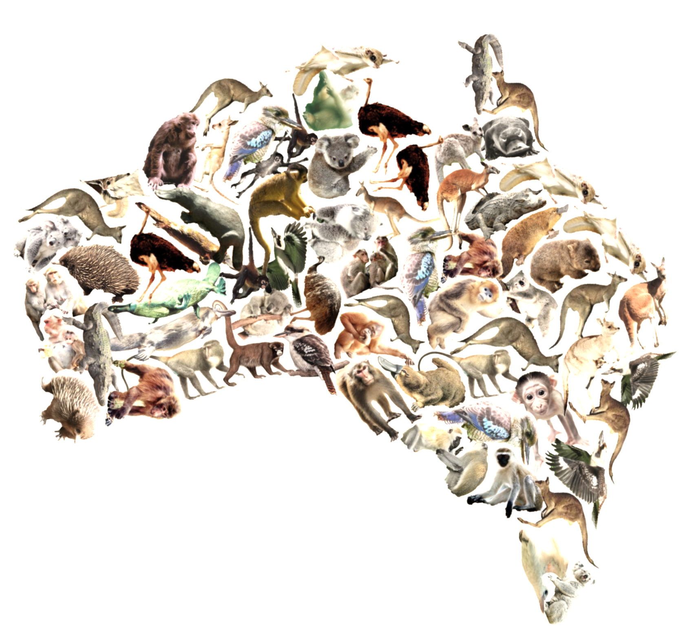
Result
Australia animal in different scale
Notes:
Another animal results with different scale.

Slide 25
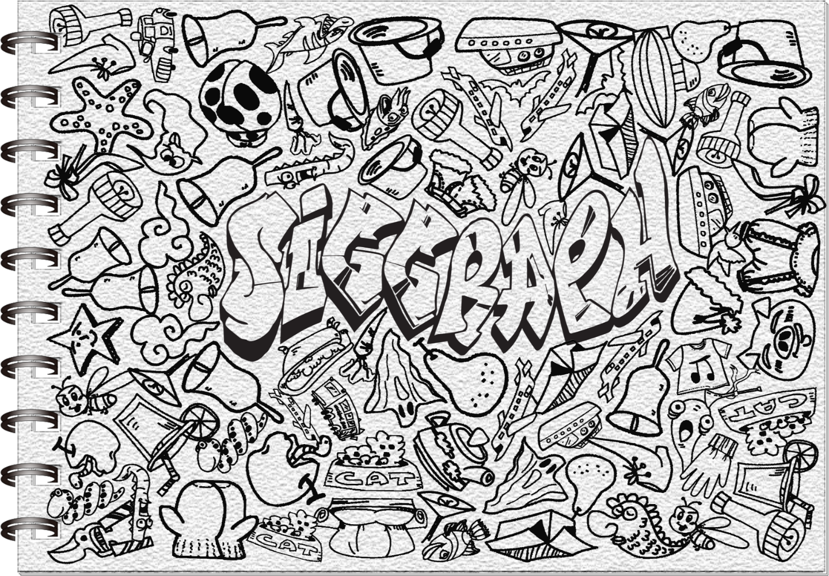
Result
Doodle with line arts
Notes:
Doodle with line arts

Slide 26
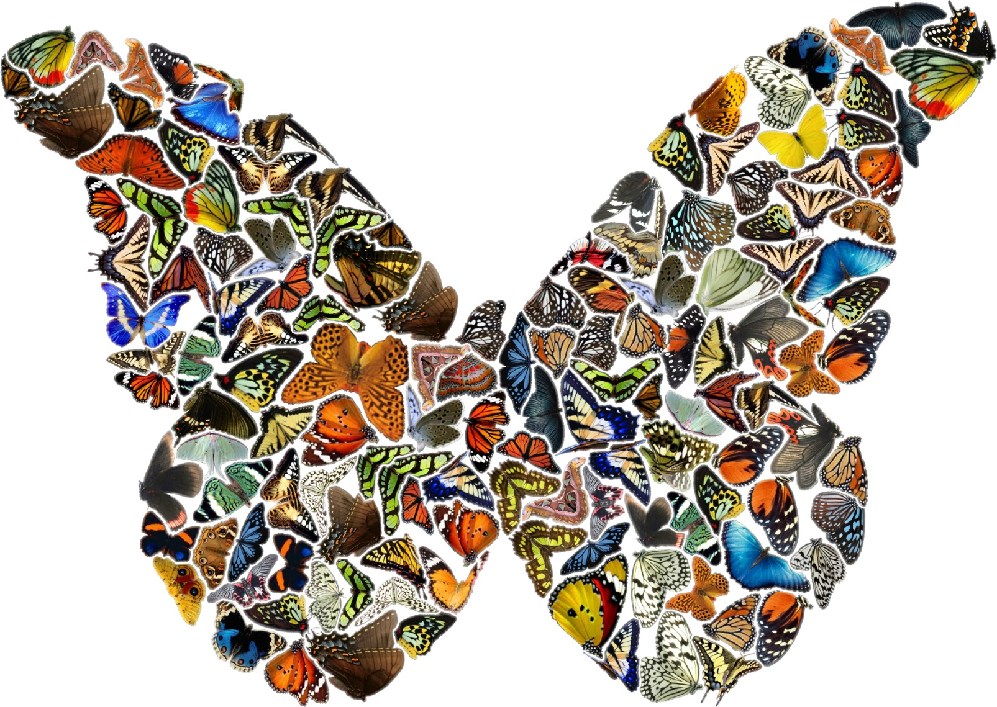
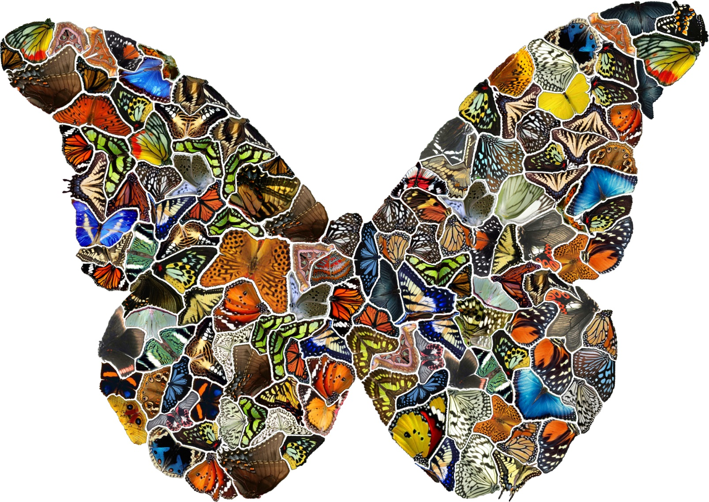
Optional Deformation
Notes:
A results using butterfly.
To further improve visual quality, we can reduce the gap and overlap by an optional deformation step.

Slide 27
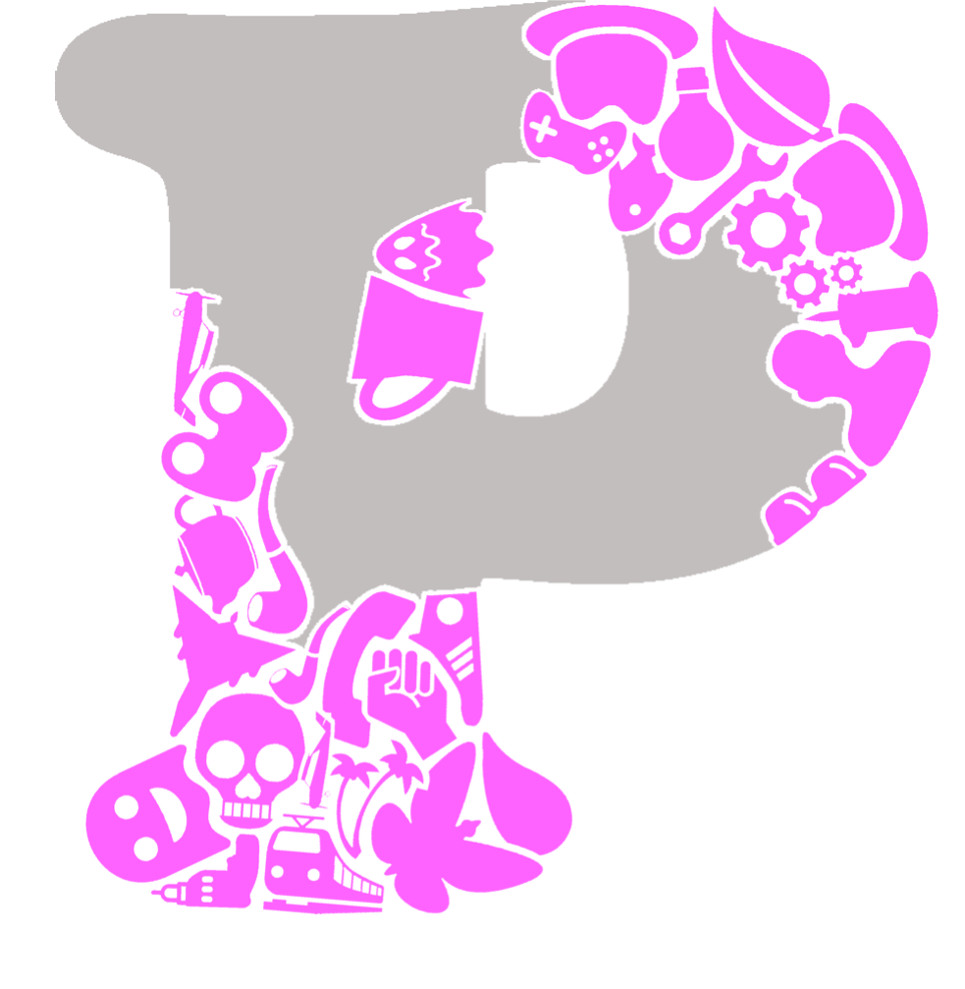
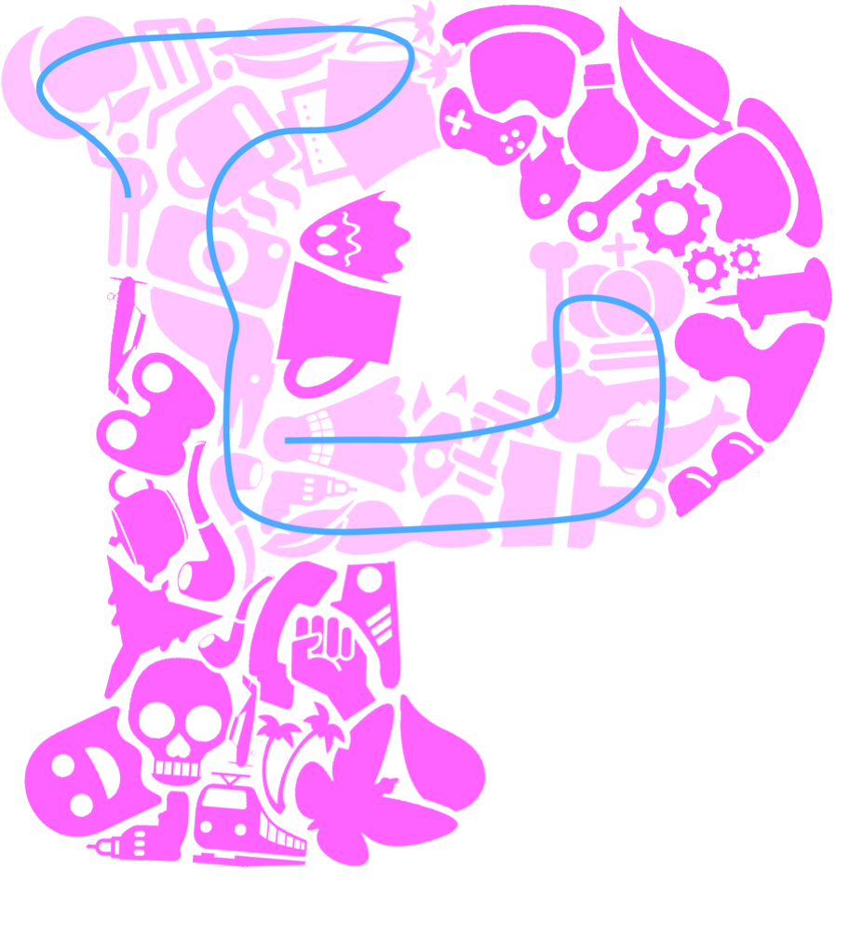


User-Controlled Refinement
Refine the result
Scribble to remove tiles
Refill the empty region with randomness
After
Before
Notes:
We also provide additional tool to allow user to refine the generated results.
First, the user need to scribble to remove the tiles.
Then, we can perform our collage generation process again to refill the empty region with some randomness introduced.
Here is the result before refinement, after refinement

Slide 28
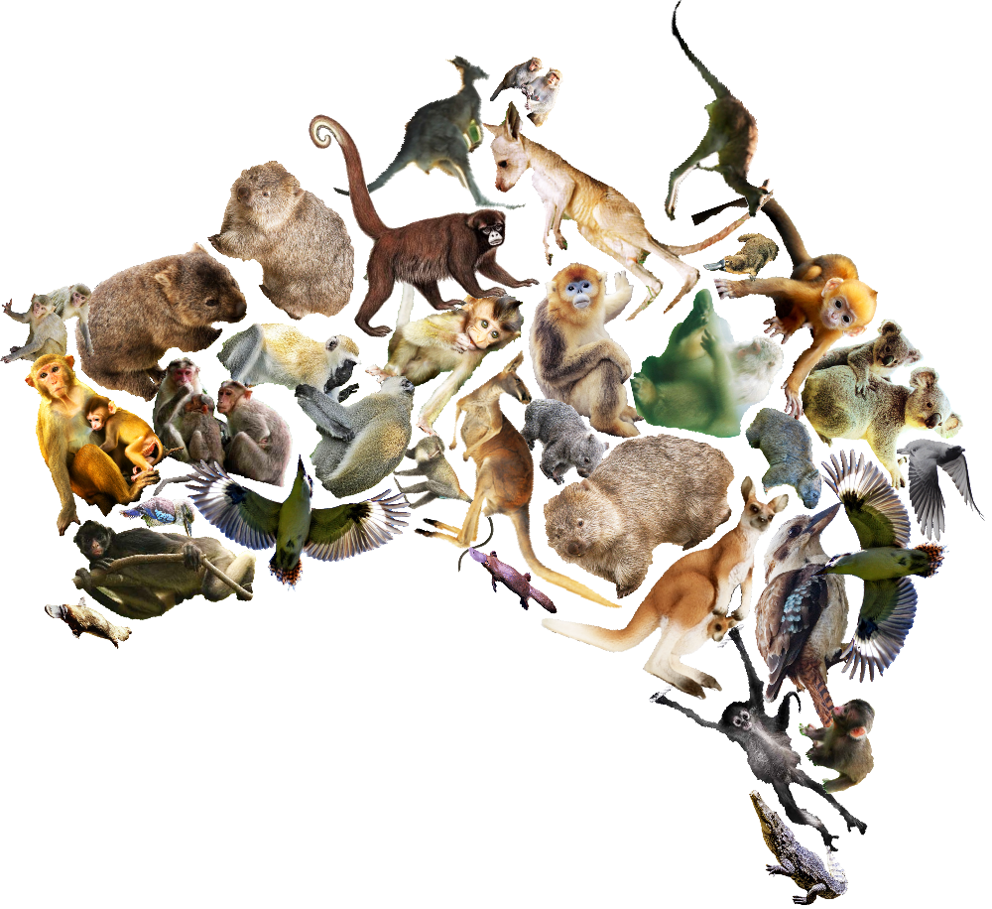
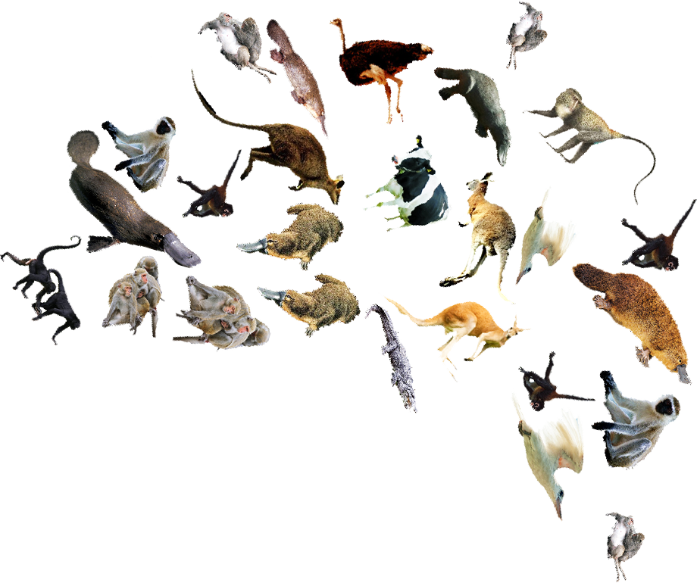
Comparison with Random Tiling
Our result is more compact
Our result
Random tiling
Notes:
Here, we compare our results with random tiling.
Obviously, our result is more compact.

Slide 29
Comparison with Other Descriptors
Tiling using existing shape descriptors
Extract
Shape instances
Notes:
We also compare our results with other shape descriptor. <click>
Recall that, other shape descriptor require to extract many segments for comparison. <click>
Since there are too many possibilities, their method are IN-efficient. <click>
To evidence this,

Slide 30
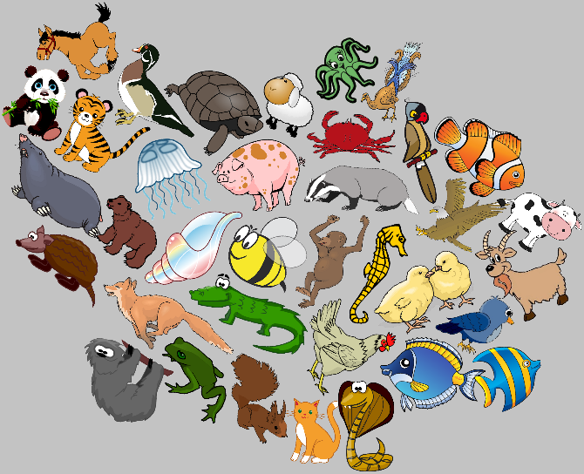
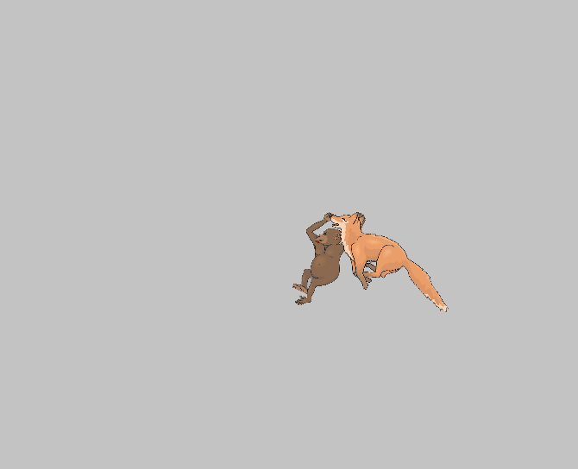
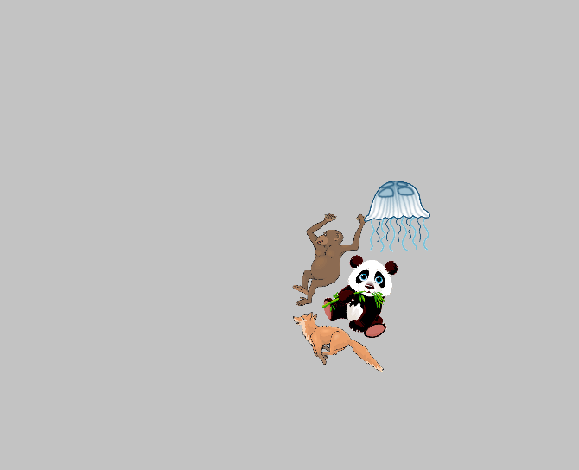
Comparison with Other Descriptors
Tiling using existing shape descriptors
35 distinct tiling pieces
Time limit: 12 hours
Our result
(750s)
Shape Context
(Time over)
Hu Moment
(Time over)
Notes:
We give them a task to pack all 35 tiling pieces into the canvas. <click>
The time limit is set to 12 hours. <click>
Our method can complete the task within 800s. <click>
However, although other descriptors exceed the time limit, they can only complete 2-4 iterations.
This evidence the efficieny of our method.

Slide 31
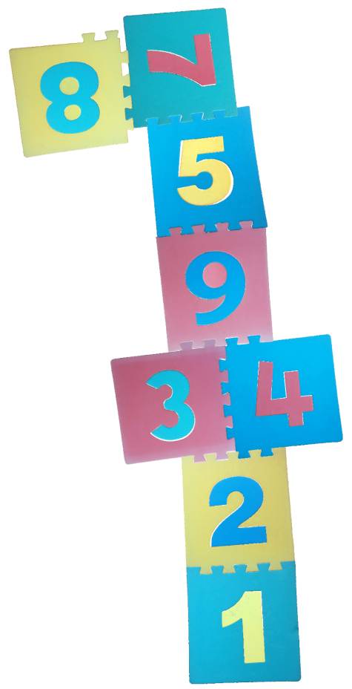
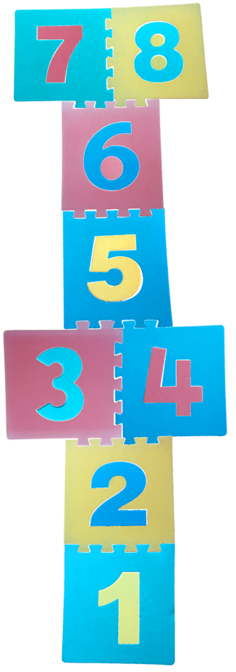
Limitations
PAD may not be noise-proof
Collage generation
Greedy nature
Non-unique boundary
Ground truth
Our result
Notes:
Our method has limitations.
For PAD, it is not noise-proof. Thus, when the noise level on the shape is too large, our method can fail.
For our bottom-up collage generation, one limitations is the greedy nature of the approach. Thus, we may not able to obtain global optimal solution.
Another limitation is the non-unique boundary. For instances, here is a puzzle with ground truth. Due to its non-unique boundary, our method may not obtain the ground truth.

Slide 32
Summary
Automatic collage generation
Strong shape coupling
Pyramid of Arclength Descriptor
Scale-invariant
Extremely efficient
Notes:
Finally, here is the summary of my presentation
We presented an automatic collage generation method, which can support arbitrary shape and achieve strong shape coupling.
To accomplish this, we present a new shape descriptor that are scale-invariant and it can perform partial-shape matching in extremely efficient way.

Slide 33

Thank you
Notes:
Thank you for your attention.

Slide 35
Backup Slides

Slide 36


Transparent Padding
Common practice to improve visual quality
Notes:
we first introduce a transparent padding to the boundary of all the shape in the library in order to improve the visual quality.
It is a very common practice of the artists during tiling.

Slide 37
Matching with/without PAD
Time statistic
Matching with 5 candidates
Our PAD
53ms
Without PAD
- 100 scale
- 100 orientation
1.9 days
Time
Notes:
To evidence this, we perform a simple partial-shape matching.
Given a shape, we matching it with 5 candidates.
With PAD, we can find out the similar portion within 60ms.
Without PAD, assume that we test 100 scale and orientation, we need to run 1.9 days in order to find out the solution.
Our PAD is more efficient, and this efficiency is the key to perform our bottom-up collage generation.

Slide 38
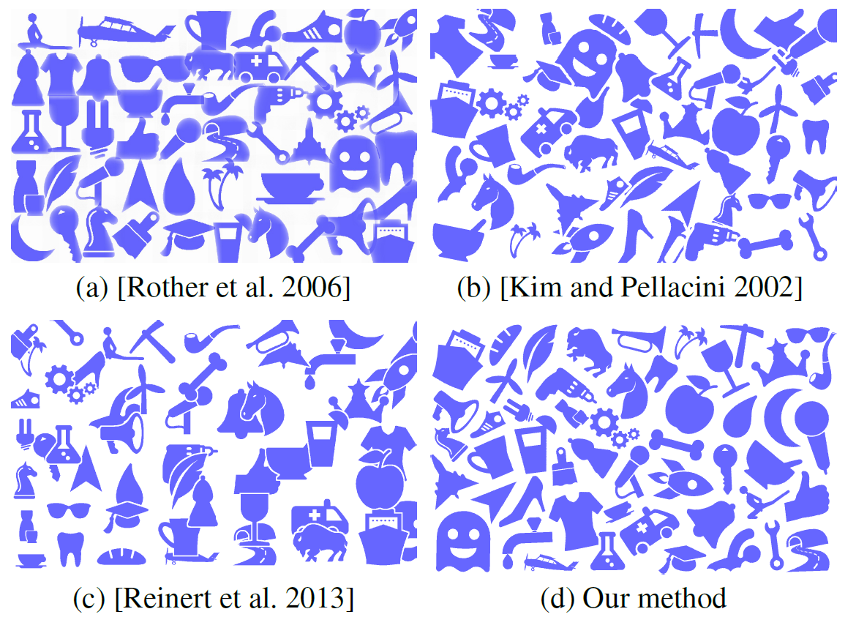
User Study

Slide 39
Existing Methods
Designed for different goal or DOF
Tiles can be rotated/ cannot be rotated
Tiles can be scaled/ cannot be scaled
All tiles must be used/ select the best one

Slide 40

User Study
13 participants
Score: 1 (Worst) to 6 (Best)
Higher is better

Slide 41
Filling within Canvas
Canvas as seed
Docking inward
2D canvas

Slide 42

Fill-in a Canvas

Slide 43

PAD Matching Results
The similarity from distance field
Perfect match
Poorly-matching

Slide 44


Further Evaluation
Longer matching is preferred
Distance field to measure the matched arclength

Slide 45


Objective Function
L : Matching length
O : Area of overlap
G : Area of gap
$ω$: Weightings

Slide 46
Ending Criterial
Stop Manually
Number of iterations
Filling Rating
Size of collage
etc.

Slide 47





Optional Deformation Step
Empty region
Voronoi-diagram
Image Morphing

Slide 48

Existing Shape Descriptor (I)
Scale-invariance by global normalization

Slide 49

Existing Shape Descriptor (II)

Slide 50

Experiment
Produce ten blocking instances for evaluation
Match

Slide 51

Experiment Result

